Slide 1
Automatic Essay Grading
Done By : Ritika S 1932039
Guide : Dr. C. Sathya

Slide 2
GOAL
The goal of this project is to create a machine learning model to learn the graders behavior in grading essays written in English.
The model can be used to automate the gradings of English essays written by students.

Slide 3
BLOCK DIAGRAM
Data
Collection
Preprocessing
Features
Extraction of features
Training
Classification
Evaluation
Evaluate using metrics
Conclude on best fitting model

Slide 4
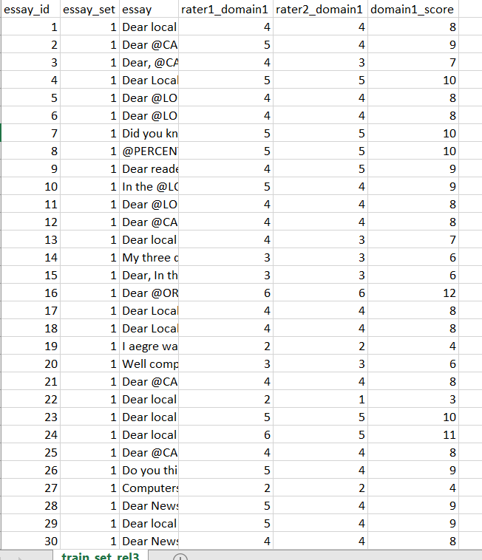
DATASET
Essay_id – Unique id of the essay
Essay_set – A set to which the essay belongs (8 sets in total)
Essay – the actual essay written in English
rater1_domain1 – Score given by rater number 1
rater2_domain1 – Score given by rater number
domain1_score – Resolved score between the two graders

Slide 5
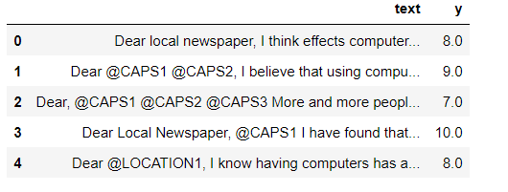
Dataset consists of 12976 essays with scores manually obtained from human evaluation from 2 different graders.
The dataset is divided into 8 essay sets based on context. Scores range from 1 to 60.

Slide 6
DATA PREPROCESSING using NLP
Lowercase
Converting all characters to lowercase
Lemmatization
Convert different forms of a word to root form.
Special characters
Removing special characters and keeping only letters
Stop words
Removal of stop words
Packages:
stop_words
nltk
WordNetLemmatizer in NLTK

Slide 7
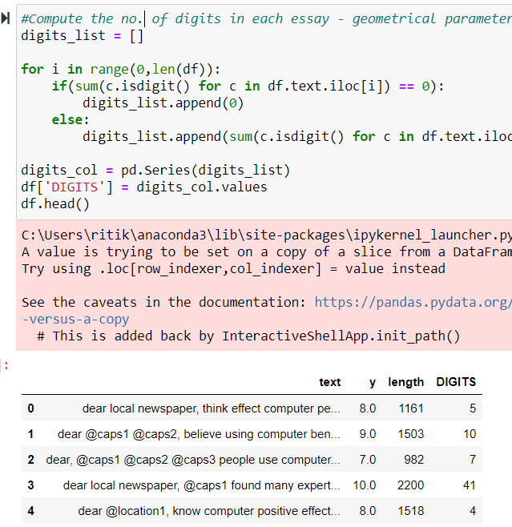
FEATURE SELECTION
Geometrical Features
Length of essay
No. of digits

Slide 8
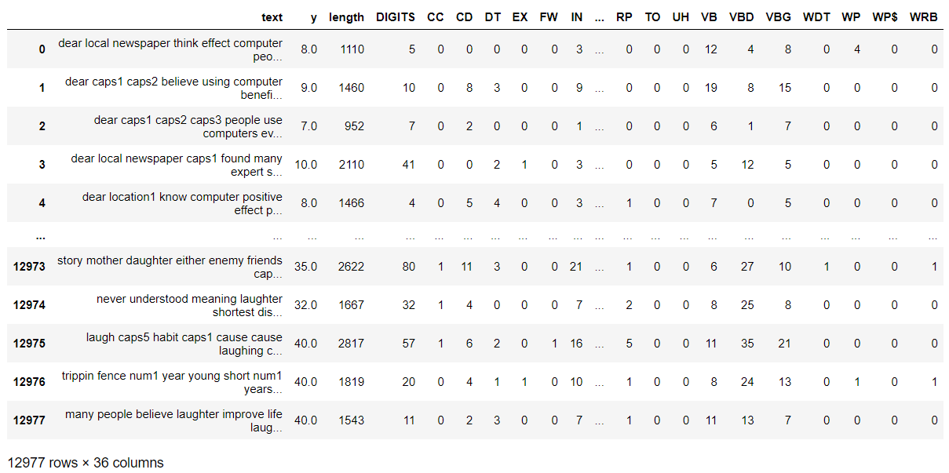
Parts of Speech - calculated the number of various parts of speech words used in the essay
Text Features - using tf-idf Vectorizer
Notes:
CC coordinating conjunction
CD cardinal digit
DT determiner
EX existential there (like: "there is" ... think of it like "there exists")
FW foreign word
IN preposition/subordinating conjunction
JJ adjective 'big'
JJR adjective, comparative 'bigger'
JJS adjective, superlative 'biggest'
LS list marker 1)
MD modal could, will
NN noun, singular 'desk'
NNS noun plural 'desks'

Slide 9
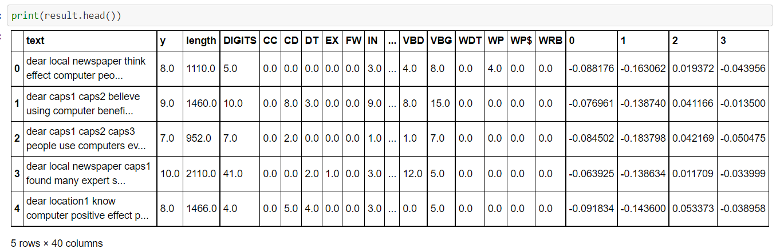
Reducing Dimensionality
→ Using PCA since the time complexity in building ml model is high.
→ Original feature space for the tf-idf sparse matrix includes 43000 + features, but reducing it down to 4 features.

Slide 10
ML Model
→ Training data = 80%
→ Testing data = 20%
Classification models
Decision Tree classification = 41%
SVM = 45%
Random Forest = 52.4%

Slide 11

Tuning the Model using GridSearch
Created a grid space. ( manually setting hyperparameters)
Using grid search trained the random forest classifier.
The best set of features found after the cross validation was 'criterion': 'entropy', 'max_depth': 80, 'n_estimators': 150).
Notes:
How many estimators (ie. decision trees) should I use?
What should be the maximum allowable depth for each decision tree?

Slide 12
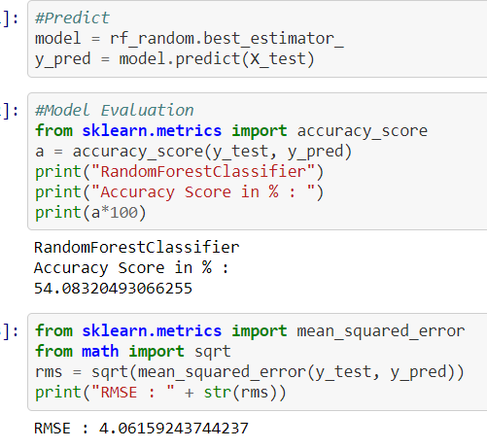
Model Evaluation
The model gives an accuracy score of 54%.
The root mean squared error in the predicted and the actual scores for the testing data came out to be around 4.
The most important feature among the feature space is the length feature which represents the length of the essay using feature_importances_.

Slide 13
Further Improvement
It is not yet been able to come considerably close to human evaluation
Adding more geometrical features like number of punctuations, number of capitalization, number of misspelled words, etc

